Slide 1



Graduation Project: Salesforce Community Management Lightning Application
Aslene Ouaze ING-A3-GL-AL-04

Slide 2
TABLE OF CONTENTS
01
02
03
04
Context
Problem & Objectives
Study of the existing
Methodologies & Tools to use
05
Work Schedule

Slide 3

Context
01

Slide 4
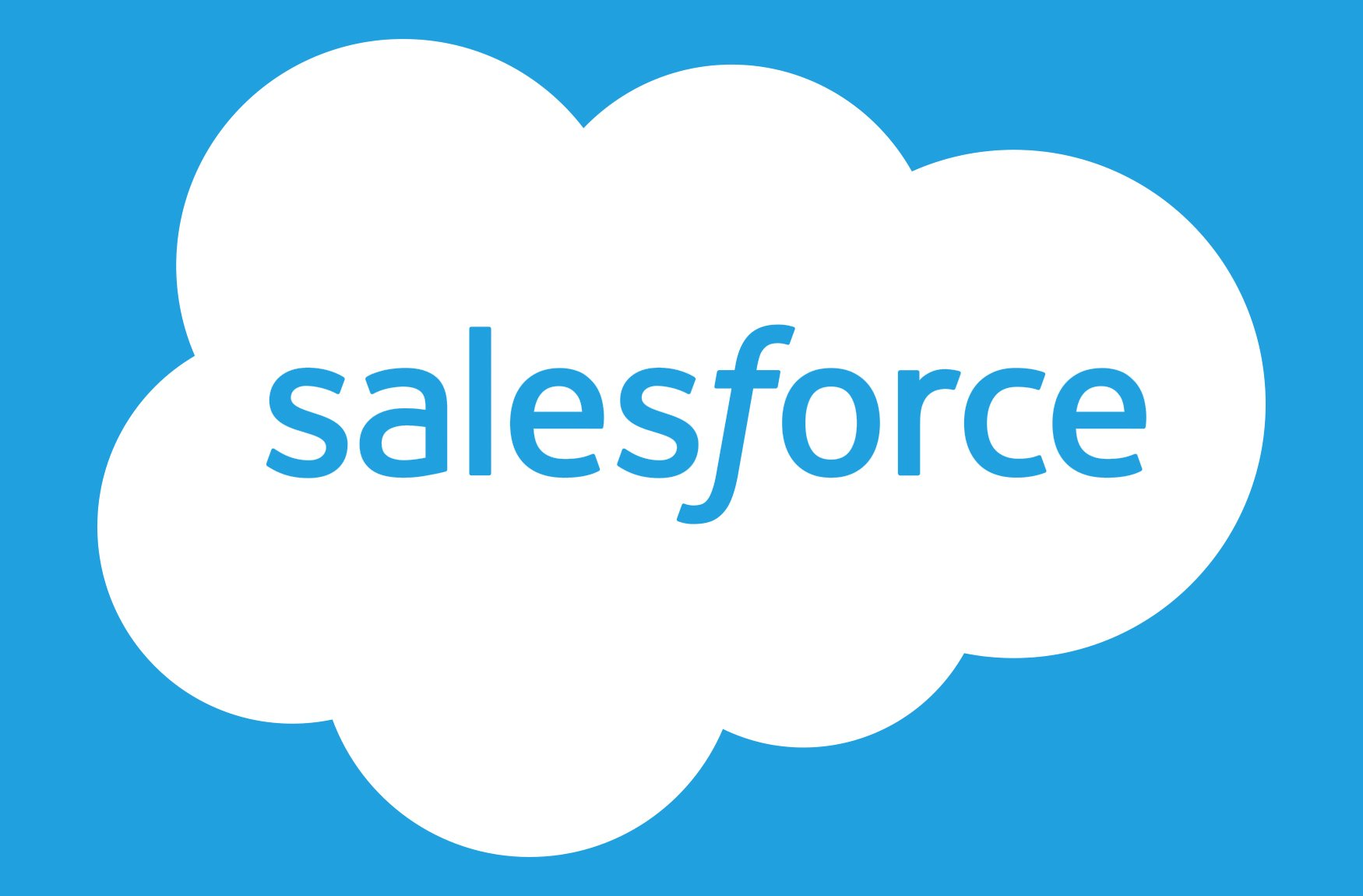
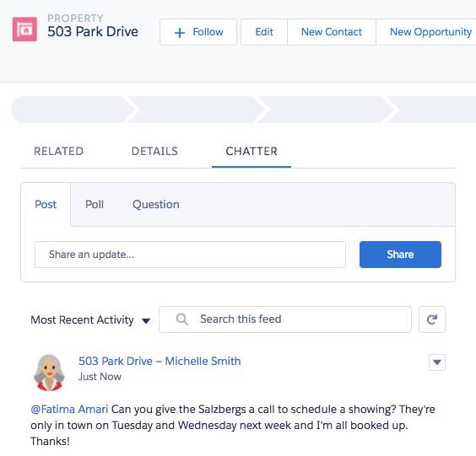
Context
Salesforce is a highly customizable advanced CRM with High Impact & Low Effort:
The platform goal is to make big changes with minimal effort
The platform goal is to solve mistakes that impact the buyer

Slide 5
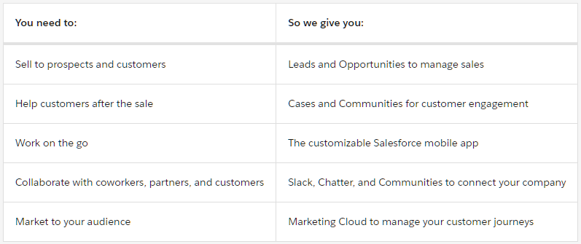
Context
Notes:
This usecase table is given as an example from the creators of salesforce to help define salesforce better

Slide 6
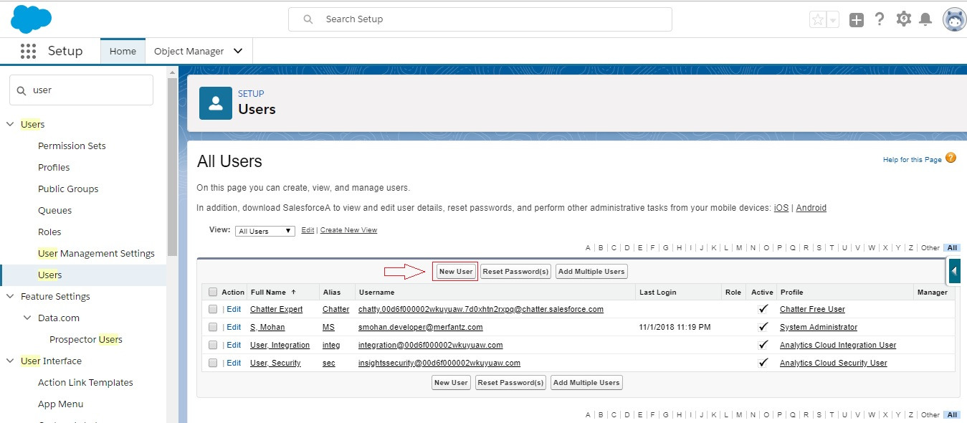
Context
In Salesforce, each user is identified by a unique username and profile.
Along with other settings, the profile determines what tasks a user can perform, what data they can view, and how they can use the data.

Slide 7
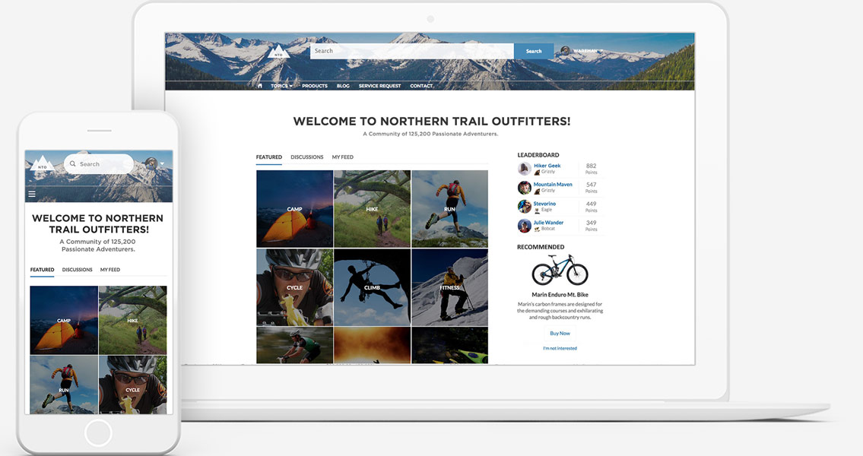
Context
As a Salesforce admin, you manage users in your organization.
In addition to creating and assigning users, user management includes managing permissions and licenses, delegating users, and more

Slide 8
Problem & Objectives
02

Slide 9

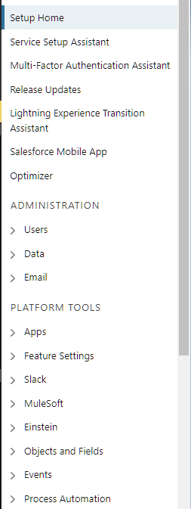
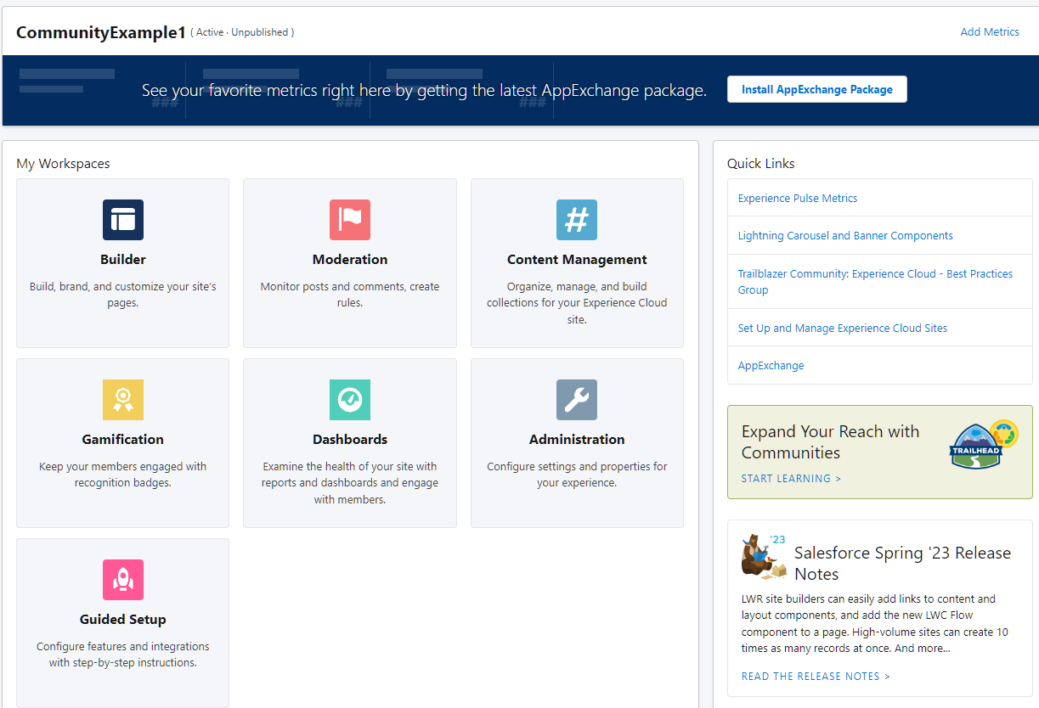
Problem
Users are managed in the community through a Salesforce interface and over several stages, making it difficult and time-consuming.
Notes:
This means there are so many places to go when trying to manage even the simplest tasks regarding users and their community so for example if the admin wants to manage all his users he will have to access the setup home but when accesing his community users he will have to access a diffrent interface that takes so much time to load

Slide 10
Objectives
It is in this context that our work is integrated, the main objective of which is to design and develop a powerful tool to facilitate the task of managing the users of the community.
This application is intended to offer any organization a simple and effective means to manage the "administration" part, then the connection history part, and finally provide a synthetic dashboard visualizing the KPIs (Key Performance Indicators)
As well as a smart solution that helps system administrators and community managers to overcome the difficulty of managing large communities and organizations through available AI solutions in salesforce

Slide 11
Study of the existing
03

Slide 12
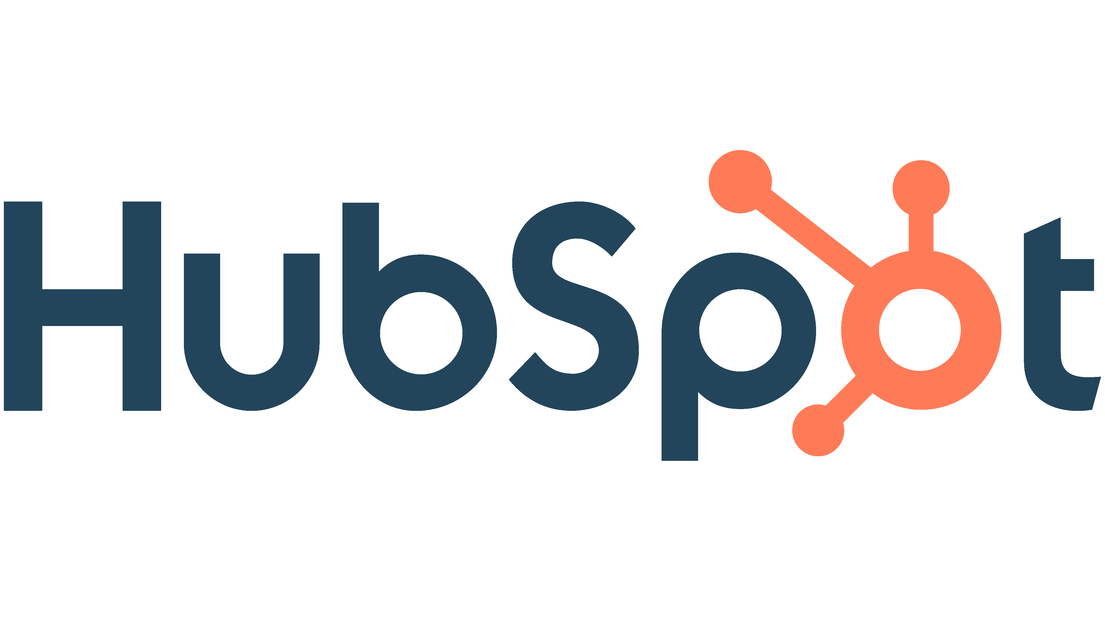
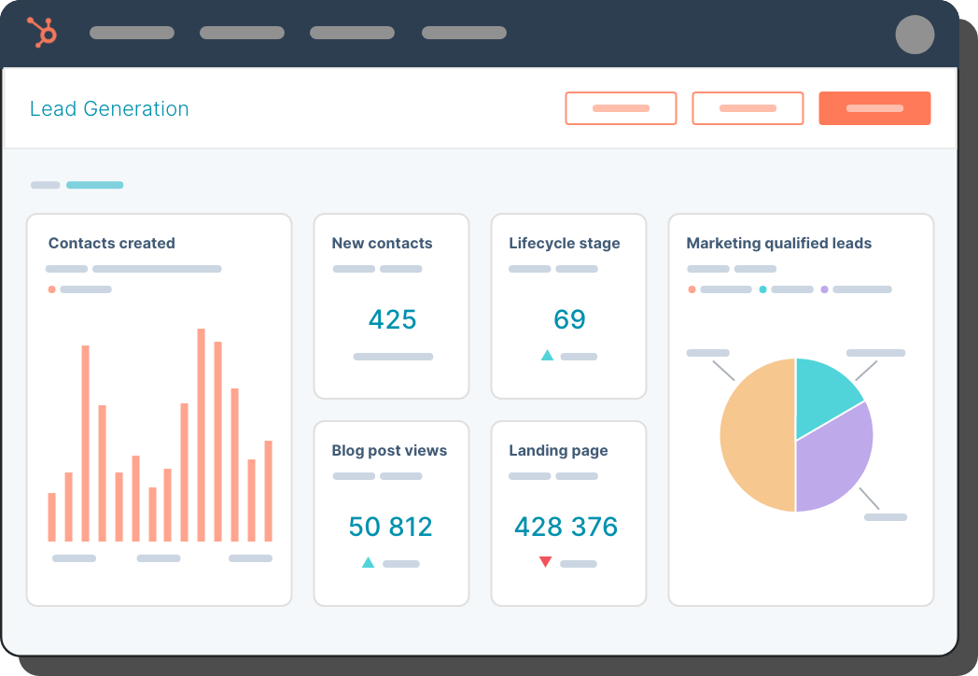
HubSpot
HubSpot is a popular marketing, sales, and customer service platform that integrates with Salesforce.
HubSpot uses Salesforce's user management features to allow organizations to manage their teams and control access to different parts of the application.

Slide 13
HubSpot
(+) Pros:
User-Friendly Interface
Role-Based Access
User Activity Tracking
(-) Cons:
Complexity
Cost
Learning Curve
Notes:
User-Friendly Interface: HubSpot's user interface is designed to be user-friendly, making it easy to manage user accounts, roles, and permissions. This helps businesses save time and increase efficiency when managing users.
Role-Based Access: HubSpot's role-based access control allows businesses to create custom roles and assign specific permissions to users based on their roles. This ensures that users only have access to the tools and data they need to do their jobs effectively.
User Activity Tracking: HubSpot tracks user activity, allowing businesses to monitor user behavior and ensure compliance with company policies and regulations.
Complexity: While HubSpot's user management interface is user-friendly, it can be complex, particularly for businesses with a large number of users. This may require more time and effort to manage and configure.
Cost: HubSpot's pricing structure is based on the number of contacts in a business's database, which can make it more expensive for businesses with larger teams. This may be a concern for businesses with many users who require access to HubSpot's tools and features.
Learning Curve: For businesses new to HubSpot, there may be a learning curve when it comes to managing users and configuring access control. This may require additional training or resources.

Slide 14
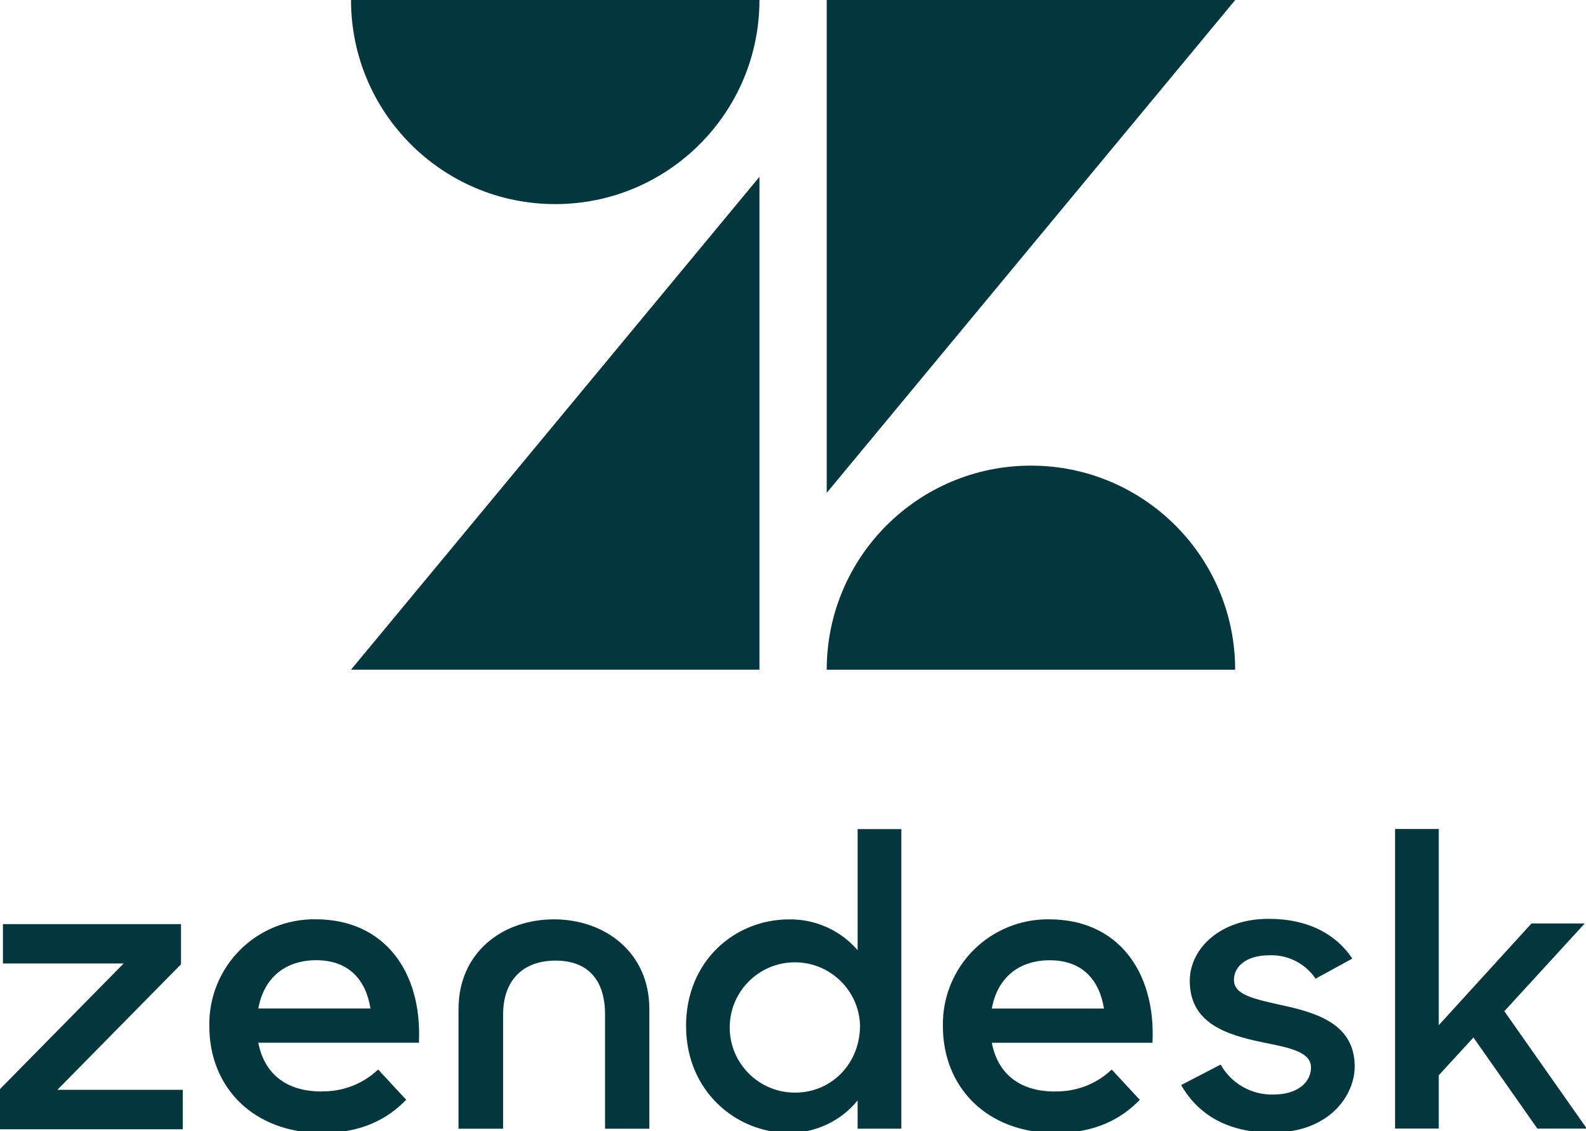
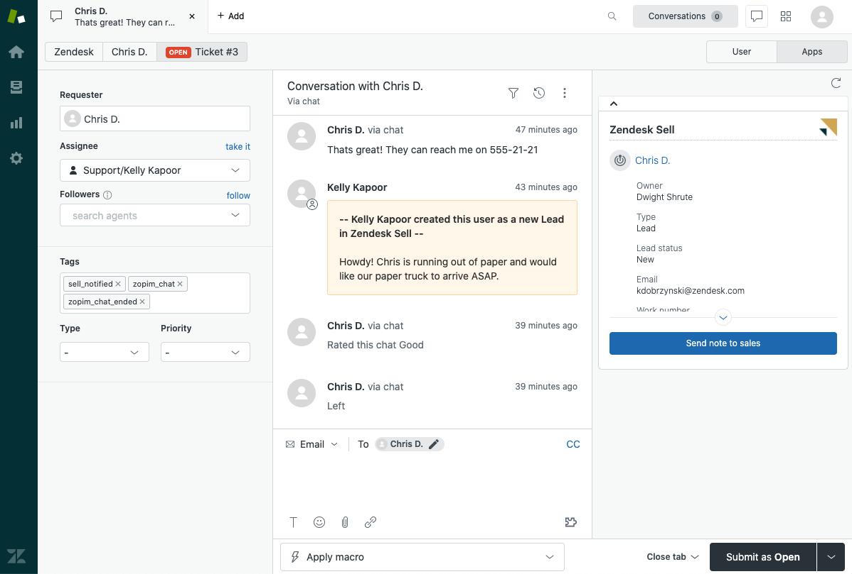
ZenDesk
ZenDesk is a customer support platform that integrates with Salesforce.
ZenDesk uses Salesforce's user management features to allow organizations to manage their support teams and control access to different parts of the application.

Slide 15
ZenDesk
(+) Pros:
User Analytics
Customizable Notifications
User Collaboration
(-) Cons:
Limited Permissions
Limited Customization
Cost
Notes:
User Analytics: Zendesk provides user analytics, allowing businesses to monitor user behavior and identify areas for improvement in the support process.
Customizable Notifications: Zendesk allows businesses to set up custom notifications for user actions, such as ticket creation or update. This helps ensure that teams stay informed and can take action quickly.
User Collaboration: Zendesk provides tools for user collaboration, such as shared views and comments, allowing teams to work together more efficiently.
Limited Permissions: Zendesk's role-based access control may not offer as much granularity as some businesses require. For example, it may not be possible to create custom permissions for individual users or specific tasks.
Limited Customization: While Zendesk's user interface is user-friendly, it may not offer as much customization as some businesses require. This may be a concern for businesses with specific branding or customization requirements.
Cost: Zendesk's pricing structure is based on the number of agents, or users who interact with customers, which can make it more expensive for businesses with larger teams. This may be a concern for businesses with many users who require access to Zendesk's tools and features.

Slide 16
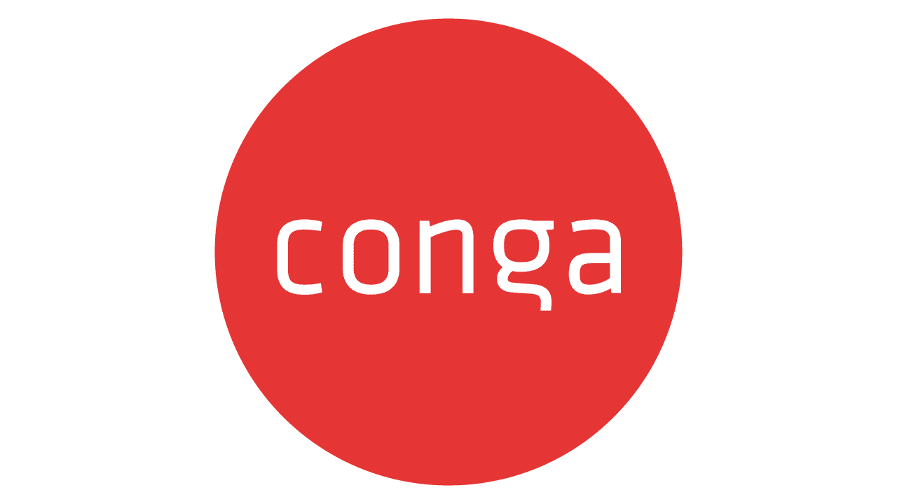
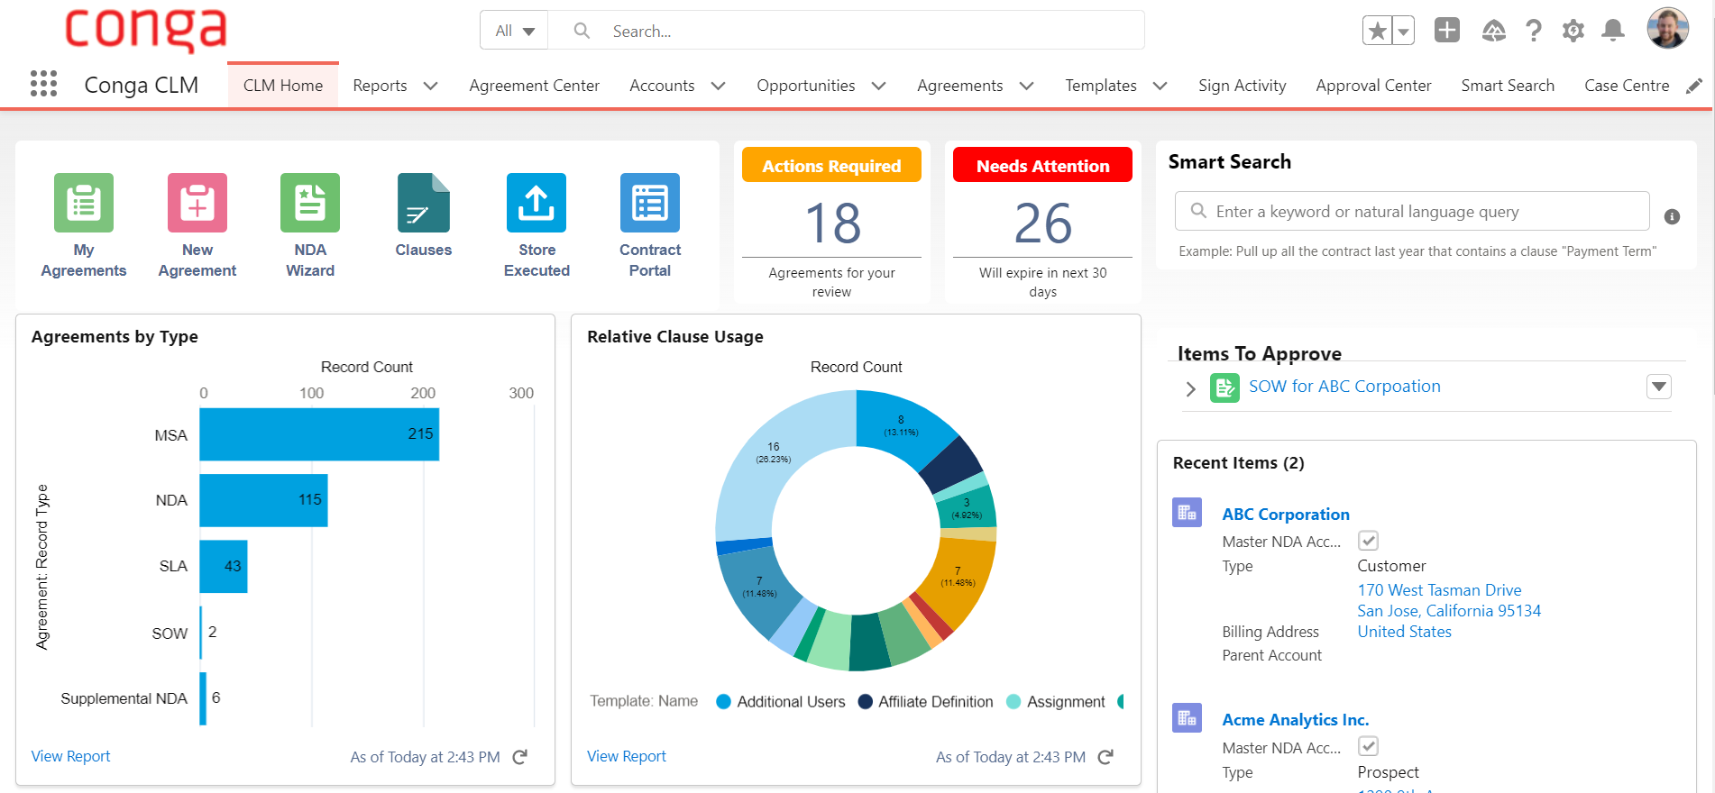
Conga
Conga is a document generation and reporting platform that integrates with Salesforce.
Conga uses Salesforce's user management features to allow organizations to manage their teams and control access to different parts of the application.

Slide 17
Conga
(+) Pros:
Customizable Workflows
Centralized User Management
Collaboration Tools
(-) Cons:
Limited Integrations
Cost
Complexity
Notes:
Customizable Workflows: Conga offers customizable workflows, allowing businesses to automate document creation and approval processes and ensure that documents are routed to the right people at the right time.
Centralized User Management: Conga provides a centralized user management system, allowing businesses to manage all their users from one central location. This saves time and ensures consistency across the organization.
Collaboration Tools: Conga provides tools for user collaboration, such as document sharing and commenting, allowing teams to work together more efficiently.
Limited Integrations: While Conga integrates with several third-party applications, some businesses may require integrations with more specialized tools or systems, which may not be available.
Cost: Conga's pricing structure can be more expensive for businesses with larger teams. This may be a concern for businesses with many users who require access to Conga's tools and features.
Complexity: Conga's user management interface can be complex, particularly for businesses with a large number of users. This may require more time and effort to manage and configure.

Slide 18
Methodologies & Tools to use
04

Slide 19
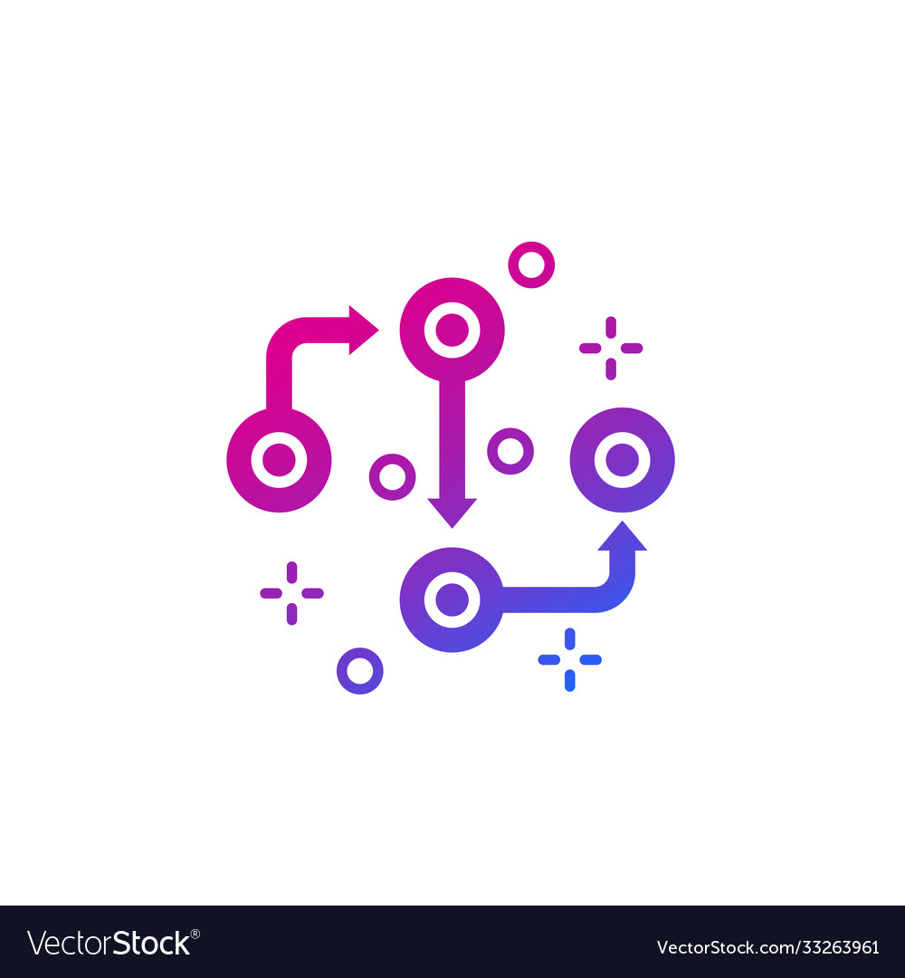
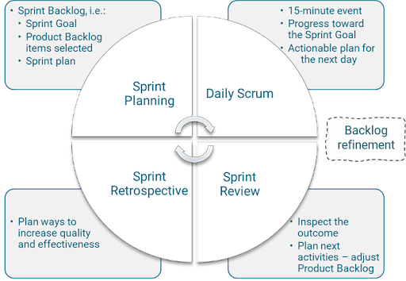
Methodology
Our chosen methodology of work for this project will be the standard SCRUM methodology.
SCRUM is a framework for project management commonly used in software development.
It is designed for teams of ten or fewer members who break their work into goals that can be completed within time-boxed iterations.

Slide 20
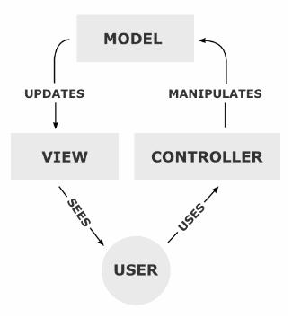
Architecture
Our chosen architecture of work for this project will be the MVC architecture since it is recommended by the Salesforce developer’s community
The Model View Controller (MVC) is a software architecture model that separates the representation of information from the user's interaction with it.

Slide 21
Tools to use
Programming language: JS, LWC, Css, Apex
Library: SLDS
Salesforce Object Query Language: SOQL, SOSL
Modeling tools: UML
Notes:
SLDS: Salesforce Lightning Design System
SOSL : Salesforce Object Search Language

Slide 22
Work Schedule
05

Slide 23
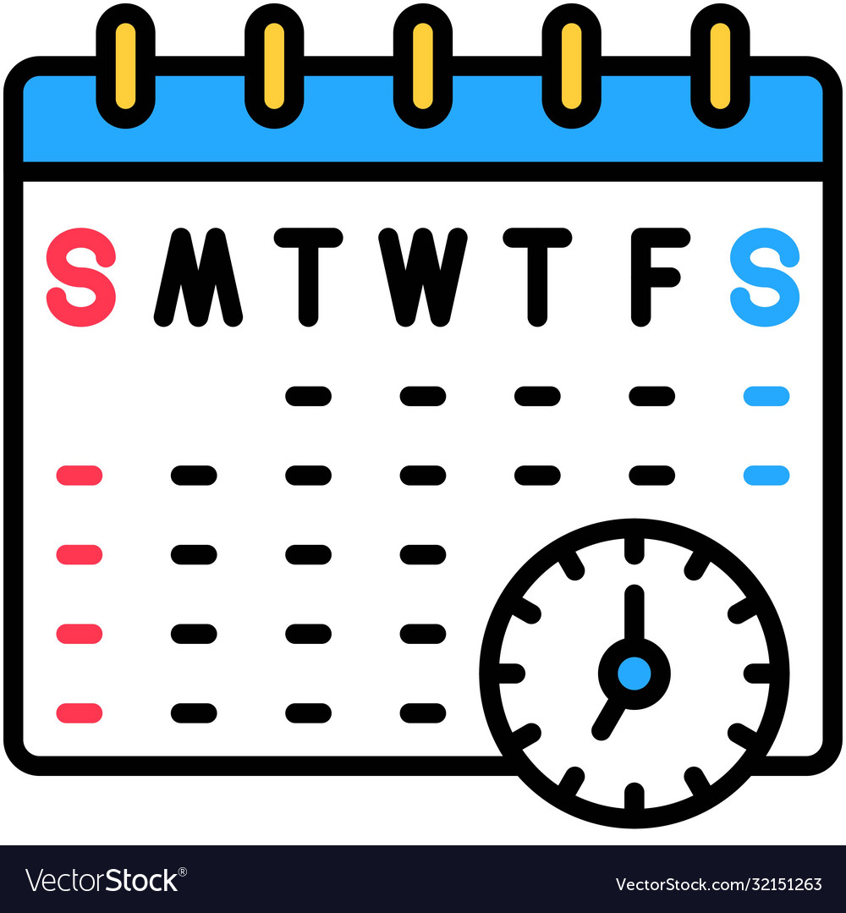
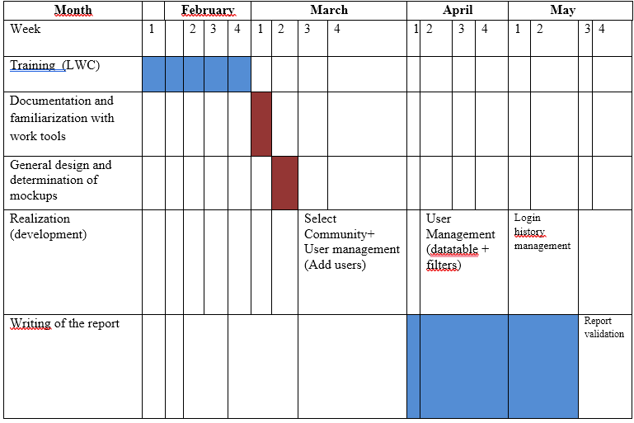
Work Schedule
The project will run for a period of 4 months. The following timeline illustrates a provisional schedule, representing the main stages leading to a functional solution that meets the criteria defined by these specifications.

Slide 24

THANK YOU

